Slide 1
Introduction to Convolutional Neural Networks
Dai Bui

Slide 2
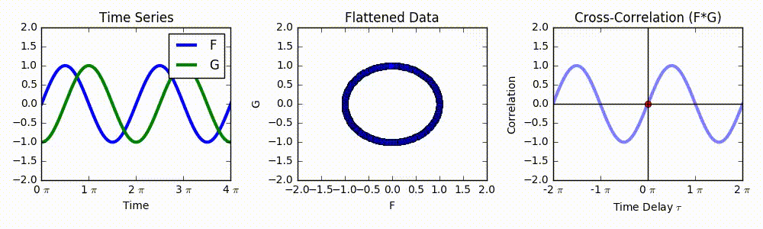

Intuition of Convolution
Convolution, similar to cross correlation of two signals is high when they look similar

Slide 3
Intuition for CNN for Pattern Recognition
Filter F1
Filter F5
How do we recognize such “eye”?
We can divide the image into smaller pieces
We will try to match (convolute) each piece with a pattern, called filter using convolution
Filter F15
F23 | F78 | F45 | F22 | F1
F19 | F15 | F16 | F14 | F5
If we see this pattern -> This is an eye!

Slide 4
Intuition for Pattern Recognition Using NN
If we want to detect if this is a person:
Detect the edges
From those edges, we form corners and complicated contours
Those corners and contours are combined to form objects, e.g., eyes, noses
Those objects then form a bigger objects, e.g, heads
Those bigger objects then form more bigger object, e.g., body
…
Higher layers will combine smaller features from lower layers to recognize more complicated objects

Slide 5
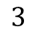
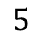
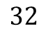
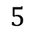
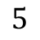
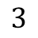
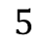
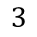
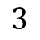
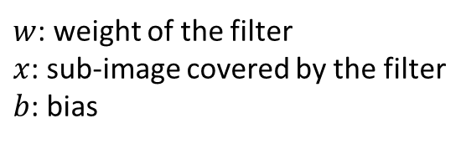
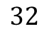
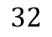
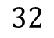
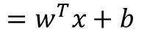
Convolution Layer
32x32x3 image is convolved with a 5x5x3 filter
Convolution: Slide the filter over the image, at each point
we compute the dot product of the filter with the region
covered by the image
$$32$$
$$5$$
$$32$$
$$5$$
$$5$$
$$=w^{T}x+b$$
$$3$$
$$5$$
$w$: weight of the filter
$x$: sub-image covered by the filter
$b$: bias
$$32$$
$$3$$
$$32$$
$$3$$
$$3$$

Slide 6
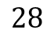
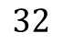
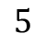
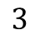
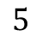
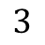
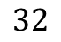
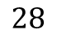
Convolution Layer
Convolve (slide) the filter over the entire image, the resulting dot products at each location create a new matrix called activation map
$$32$$
$$28$$
$$5$$
$$5$$
$$3$$
$$28$$
$$32$$
1
$$3$$

Slide 7
Convolution Layer
Each filter creates one activation map
$$32$$
$$32$$
Newly formed activation maps are stacked up to create new image
$$3$$

Slide 8
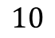
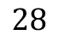

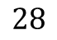

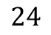
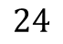
Example: ConvNet Architecture
A sequence of convolution layers
$$32$$
$$28$$
$$24$$
…
Convolve
with 6 5x5x3
filters, then ReLU
Convolve
with 10 5x5x6
filter then ReLU
$$32$$
$$28$$
$$24$$
$$3$$
$$6$$
$$10$$

Slide 9
VGG-16 Architecture

Slide 10
Car Recognition Example

Slide 11
Convolution in Details
Convolution with stride 1

Slide 12
Convolution in Details
Convolution with stride 2

Slide 13
Padding
0 | 0 | 0 | 0 | 0 | 0
0
0
0
Insert 0 outside of the border of the image
7x7 image padded with one more pixel at the border
then convolved with one 3x3 filter will produce 7x7 output

Slide 14
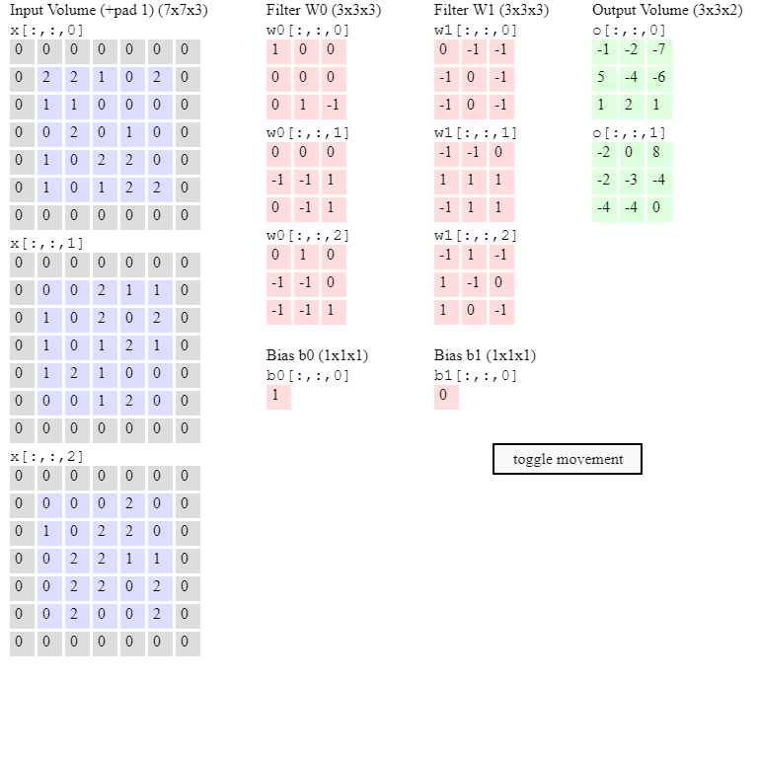
Convolution Example

Slide 15
Pooling
1 | 2 | 4
8 | 7 | 5
9 | 6 | 8
What happens if we have too many layers and the activation maps are big?
We want to scale it down
How do we scale it down?
For each submatrix, say 3x3 as in this case, we replace it with a single value
Max pooling: submatrix is replace with its maximum value, in this case is 9
Average pooling: submatrix is replace with its average value, in this case is 7
9

Slide 16


Pooling

Slide 17
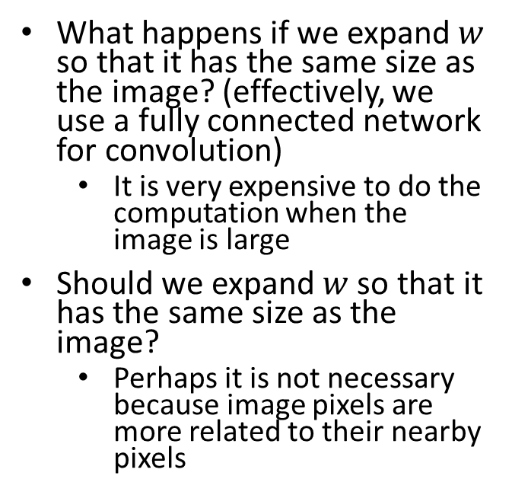
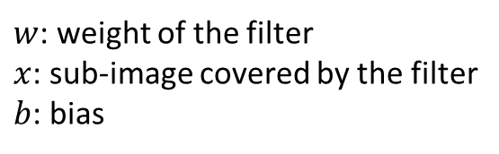
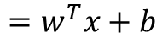
Convolution Questions
Convolution: Slide the filter over the image, at each point
we compute the dot product of the filter with the region
covered by the image
What happens if we expand $w$ so that it has the same size as the image? (effectively, we use a fully connected network for convolution)
It is very expensive to do the computation when the image is large
Should we expand $w$ so that it has the same size as the image?
Perhaps it is not necessary because image pixels are more related to their nearby pixels
$$32$$
$$5$$
$$=w^{T}x+b$$
$$5$$
$w$: weight of the filter
$x$: sub-image covered by the filter
$b$: bias
$$3$$
$$32$$
$$3$$

Slide 18
CNN Practice

